Slide 1
Crop prediction system
Using Machine learning

Slide 2
Crop Prediction System using machine learning
Major Project
Supervised by- D. Abdul Jaleel
Presented by:-
P. Vishnuvardhan Naidu 19691A28H9
CR. Tejavardhan Reddy 19691A28F8

Slide 3
Contents
1. OBJECTIVES
2.RESEARCH GAP
3.PREVIOUS REVIEW COMMENTS
4. INCORPORATED MODIFICATIONS
5.ARCHITECTURE DIGRAM
6. DATA SET
7. INPUT/EXPECTED OUTCOME
8.METHODOLOGY OF THE PROPOSED WORK IN DETAIL
9.ALGORITHM USED IN DETAIL
10.PROJECT DESIGN - UML DIAGRAMS
11. PARTIAL IMPLEMENTATION

Slide 4
abstract
For most developing countries, agriculture is their primary source of revenue. Modern agriculture is a constantly growing approach for agricultural advances and farming techniques.
It becomes challenging for the farmers to satisfy our planet's evolving requirements and the expectations of merchants, customers, etc. Some of the challenges the farmers face are-
Nutrient deficiency in the soil, caused by a shortage of crucial minerals such as potassium, nitrogen, and phosphorus can result in reduced crop growth.
Farmers make a mistake by cultivating the same crops year after year without experimenting with different varieties. Agriculture is the most important supply of Indian Economy.
For the better crop yield, the farmers always require a correct crop that can give good yield in that particular soil. It is predicting the future possible crops that can be sowed in soil with its respective NPK percentages

Slide 5
OBJECTIVEs
The primary goal of this study is to examine, evaluate and identify the suitable crop using trained models present in the dataset.
And also increase the accuracy in detecting the prediction of crop by using KNN Algorithm.

Slide 6
research gap
The current system was based on the environment, such as rainfall,humidity and temperature.
The sudden changes in the temperature leads to damage of the crops.
Our methodology makes use of the NPK values of the soil, which reduces the crop damage.
The current system also predicts whether the soil is suitable for farming or not.

Slide 7
Average Acceptance rate of NPK
Nitrogen(N) : 40-120ppm
Phosphorous(P) : 40-80ppm
Potassium(K) : 40-80ppm

Slide 8
previous review comments
Processed to further implementation part.

Slide 9
incorporated modifications
We are using the NPK values to make the suitable choice for the soil.
These were used along with the climatic conditions.
This proposed system also predicts whether the soil is suitable for the farming or not.

Slide 10
dataset
Dataset | features | Emotion model | Download linnk
Crop Recommendation Dataset | Precision agriculture is in trend nowadays. It helps the farmers to get informed decision about the farming strategy. | Discrete | https://www.kaggle.com/datasets/atharvaingle/crop-recommendation-dataset?resource=download

Slide 11
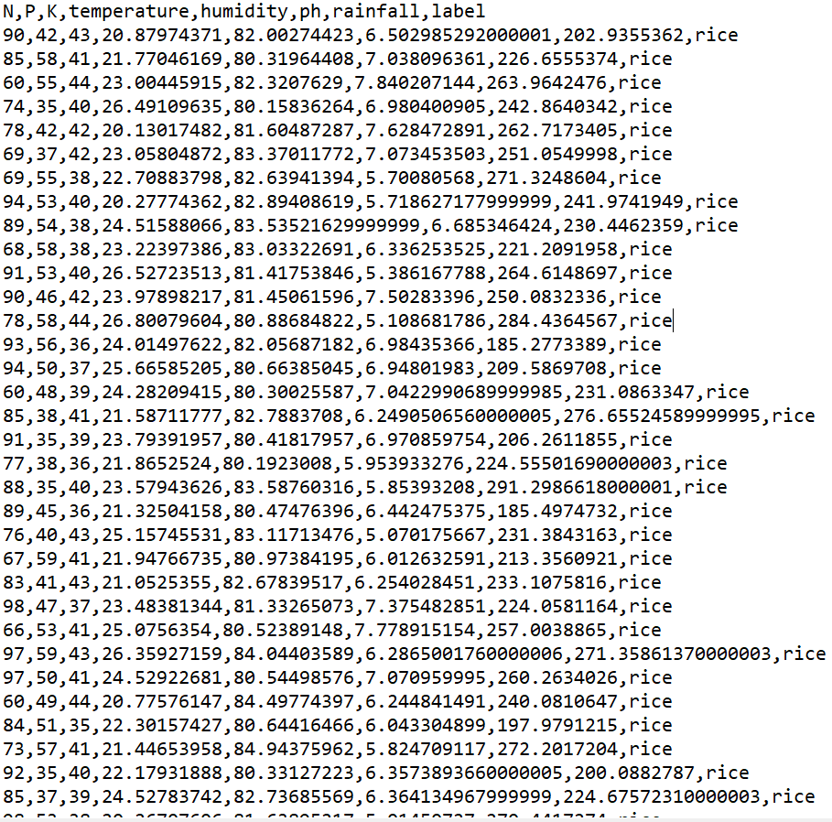

Slide 12
Attributes in dataset
Grains | Fruits | Plantation Crops | Legumes/Pulses
Rice | Orange | Coffee | Peas
Maize | Apple | Cotton | Ground nuts
Wheat | Grapes | Jute | Chickpea
 | Pomogranate |  | Kidney beans
 | Banana |  | Pigeon peas
 | Mango |  | Moth beans
 | Water melon |  | Mung beans
 | Musk melon |  | Lentil
 | Papaya |  | Black Grams
 | Coconut

Slide 13
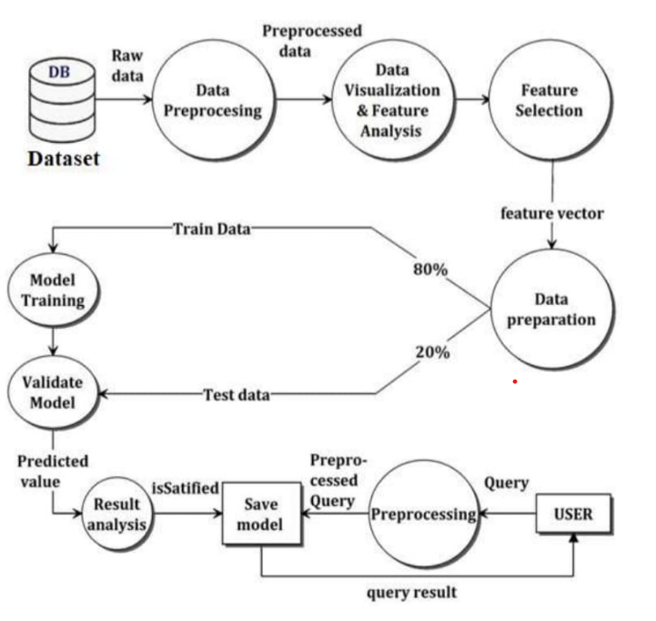
architecture diagram

Slide 14
Input/Expected Outcome
Data Collection and PreProcessing:
Data collection is the most efficient method for collecting and measure the data from different
resources.
To get an approximate dataset for the system. This dataset must contain the following attribute
NPK values, those parameters will consider for crop prediction.
After collecting datasets from various resources. Dataset must be preprocessing before training to the model. The data preprocessing can be done by various stages, begins with reading the collected dataset.
The process continues to data cleaning. In data cleaning the datasets contain some redundant attributes, those attributes are not considering for crop prediction.
So, we have to drop unwanted attributes and datasets containing some missing values we need to drop these missing values or fill with unwanted nan values in order to get better accuracy.
Then define the target for a model

Slide 15
METHODOLOGY
This method starts with the training of the dataset.
Once the data gets trained the testing data will be given.
The testing data will be tested based on the features and the levels of NPK in the soil.
Based on the soil fertility, climate and zone the processing will be happen.
At last the data will be given to the user.

Slide 16
algorithm used
K-Nearest Neighbour(KNN) Algorithm for Machine Learning
K-Nearest Neighbour is one of the simplest Machine Learning algorithms based on Supervised Learning technique.
K-NN algorithm assumes the similarity between the new case/data and available cases and put the new case into the category that is most similar to the available categories.
K-NN algorithm can be used for Regression as well as for Classification but mostly it is used for the Classification problems.
It is also called a lazy learner algorithm because it does not learn from the training set immediately instead it stores the dataset and at the time of classification, it performs an action on the dataset.

Slide 17
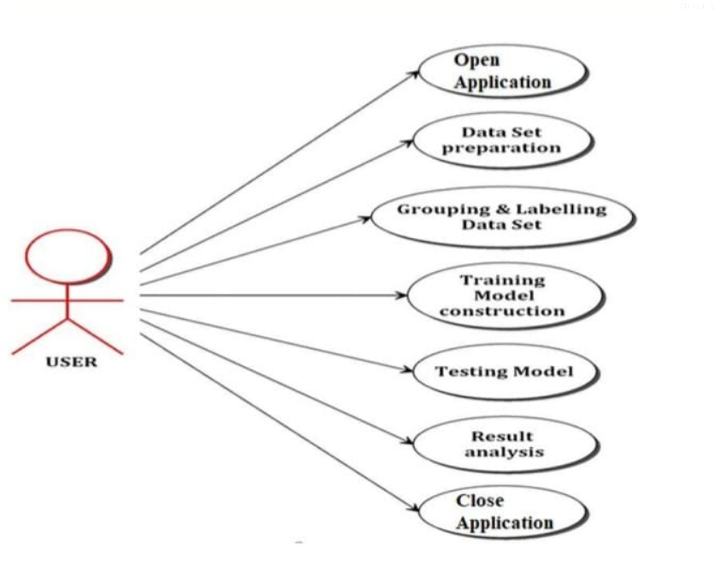
project design-uml diagram usecase

Slide 18
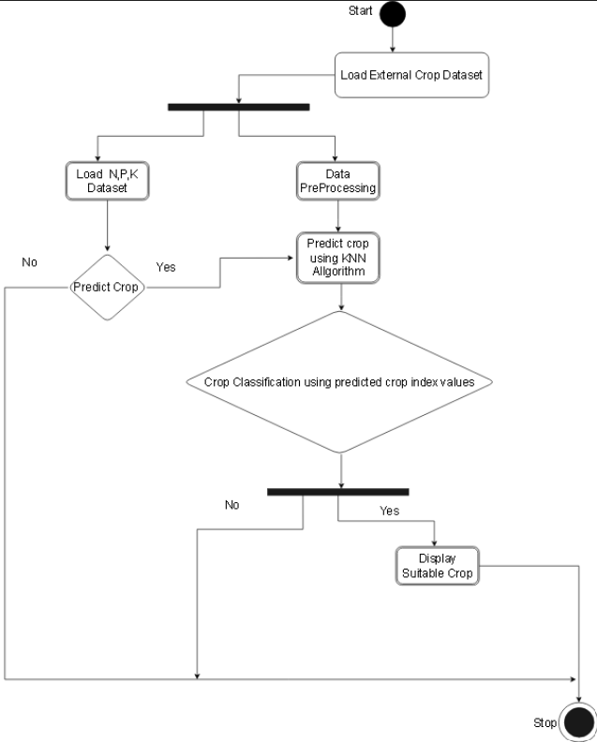
activity diagram:

Slide 19
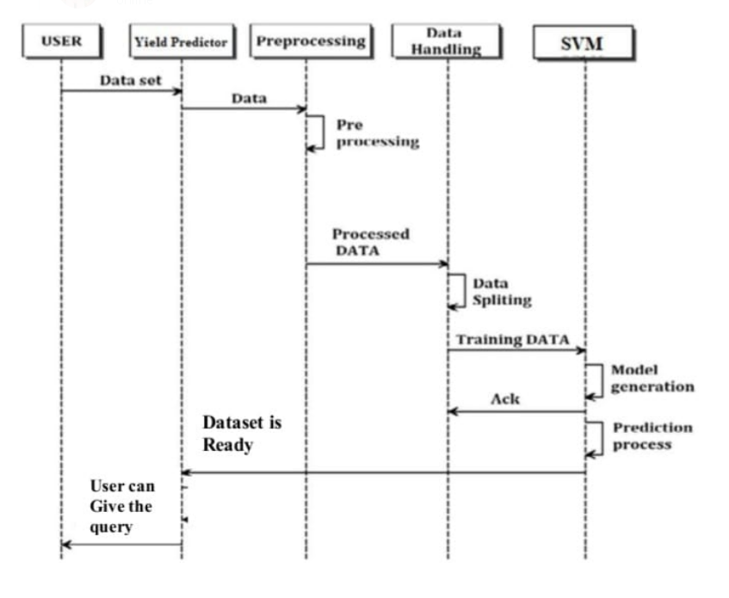
sequence diagrAM

Slide 20
THANK YOU

